Slide 1
Lexical Analysis
COP 4020

Slide 2
Overview of Language Translation
Lexical Analysis
Parsing
Static Semantic Analysis
Code Generation

Slide 3
Overview of Language Translation
Lexical Analysis
Performed by a Lexer or Scanner.
Convert sequence of characters into a sequence of potential tokens.
Lexical structure typically specified with regular expressions.
Parsing
Static Semantic Analysis
Code Generation

Slide 4
Overview of Language Translation
Lexical Analysis
Parsing
Performed by a Parser.
Recognizes legal phrases [token order] using the rules of a grammar (CFG).
Converts token sequence into an Abstract Syntax Tree (AST).
Does not use regular expressions.
Static Semantic Analysis
Code Generation

Slide 5
Overview of Language Translation
Lexical Analysis
Parsing
Static Semantic Analysis
Type checking is completed.
Code Generation

Slide 6
Overview of Language Translation
Lexical Analysis
Parsing
Static Semantic Analysis
Code Generation
May involve several phases, depending up on how much optimization is included.

Slide 7
Syntax vs Semantics
Syntax describes the structure of a language.
Semantics describe the meaning that may be found in the language.
It is convenient to consider syntax and semantics separately.
Syntax is much easier to describe.

Slide 8
Syntax
Lexical Structure: legal tokens [words]
Phrase Structure: how tokens may be arranged
if ( balance < 0 ) {
return “Account Overdrawn”;
}

Slide 9
Lexical Structure
Token | Kind | Type
if | keyword
( | left paren
balance | identifier
< | operator
0 | numerical literal
) | right paren
{ | left brace
return | keyword
“Account Overdrawn” | string literal
; | semicolon
} | right brace
Defines how the character sequence is divided into a sequence of tokens.

Slide 10
Phrase Structure [briefly for now…]
According to phrase structure, this is a legal statement:
the if keyword is followed by an expression enclosed in parentheses,
which is followed by a block enclosed in braces
that contains a statement terminated with a ;
if ( balance < 0 ) {
return “Account Overdrawn”;
}

Slide 11
Lexical Structure
Q: Why do we use formal notation?
A: Precise definition ensures lexical rules are clear.
Java, C, C++… YES!
Rational Constants
is .1 allowed?
is 10. allowed?
Rational Constants
1..15 is a rang specifier
Lexer might confuse
this with 1. and .15!
Pascal, Ada … NO!

Slide 12
Example: [simple] Numeric Literals
We give names [labels] to regular expressions and use them in other regular expressions as if they were symbols.
<num lit> ::= <nonzero digit> <digit>* | 0
<digit> ::= 0 | <nonzero digit>
<nonzero digit> ::= 1 | 2 | 3 | 4 | 5 | 6 | 7 | 8 | 9
Orange denotes a literal character values.

Slide 13
Example: Identifiers
<identifier> ::= <identifier start> <identifier part>*
<identifier start> ::= A..Z | a..z | $ | _
<identifier part> ::= <identifier start> | <digit>

Slide 14
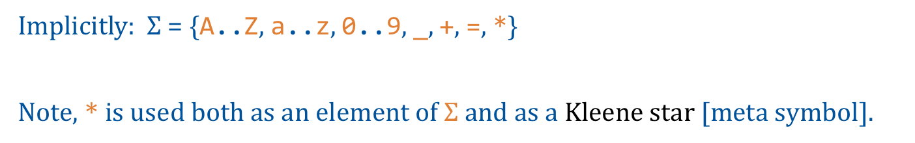
Example: Operators
<input> ::= <token>*
<token> ::= <identifier> | <num list> | <op>
<op> ::= + | == | *
Implicitly: $Σ$ = {A..Z, a..z, 0..9, _, +, =, *}
Note, * is used both as an element of $Σ$ and as a Kleene star [meta symbol].

Slide 15
Example: Inline Comments and Not()
<inline comment> ::= // (Not(EOL))* EOL
Single line comment.
Within the sequence of characters making up the comment, the end-of-line (EOL) character is not allowed.
Not(element): represents negation of the element listed.

Slide 16
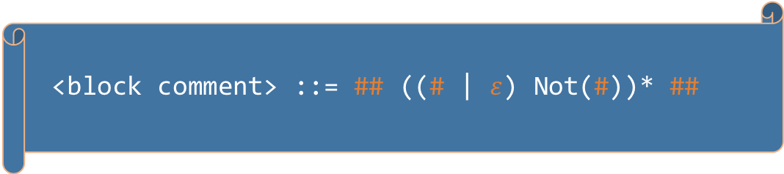
Example: Block Comments
<block comment> ::= ## ((# | $ε$) Not(#))* ##
Comment delimited by ##.
What is the shortest legal string?
Which of these are legal strings?
##abc##
##abc##abc##
##abc#abc##

Slide 17
Recognizing Tokens
REs specify or generate tokens.
We need to recognize tokens.
A Deterministic Finite Automaton (DFA|DFSM) is used to recognize the language that can be generated by a given RE.
We call this part of compilation Lexical Analysis.
The interpreter | compiler component that performs lexical analysis is called a Lexer or Scanner.

Slide 18
Lexers | Scanners
Responsible for tokenizing source as specified by RE.
Also:
Removing comments
[often] dealing with pragmas [significant comments]
Saving text of identifiers, numbers, strings
Saving source locations [file, line, column] for error message

Slide 19
Building Lexers
Ad-hoc
Semi-mechanical pure DFA [usually realized as nested case statements]
Table-driven DFA

Slide 20
Building Lexers
Ad-hoc
Semi-mechanical pure DFA [usually realized as nested case statements]
Table-driven DFA
Ad-hoc generally yields the fastest, most compact code by performing lots of special purpose operations, though good automatically-generated scanners come close

Slide 21
LEXING
<token> ::= <identifier> | <num lit> | <op>
<num lit> ::= <nonzero digit> <digit>* | 0
<digit> ::= 0 | <nonzero digit>
<nonzero digit> ::= 1 | 2 | 3 | 4 | 5 | 6 | 7 | 8 | 9
<identifier> ::= <identifier start> <identifier part>*
<identifier start> ::= A..Z | a..z | $ | _
<identifier part> ::= <identifier start> | <digit>
<op> ::= + | == | *
Given a sequence of characters, scan input from left to right, extending a token as long as possible.

Slide 22
Lexing
<token> ::= <identifier> | <num lit> | <op>
<num lit> ::= <nonzero digit> <digit>* | 0
<digit> ::= 0 | <nonzero digit>
<nonzero digit> ::= 1 | 2 | 3 | 4 | 5 | 6 | 7 | 8 | 9
<identifier> ::= <identifier start> <identifier part>*
<identifier start> ::= A..Z | a..z | $ | _
<identifier part> ::= <identifier start> | <digit>
<op> ::= + | == | *
abc0def12g
a single token
abc+45d
a=d
01
a

Slide 23
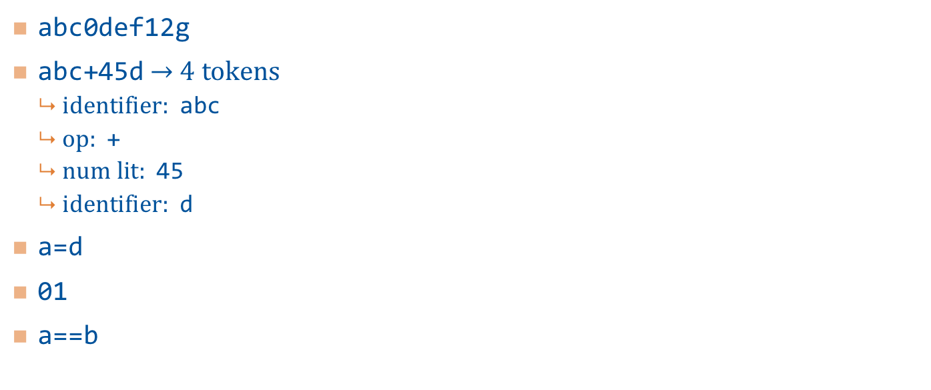
Lexing
<token> ::= <identifier> | <num lit> | <op>
<num lit> ::= <nonzero digit> <digit>* | 0
<digit> ::= 0 | <nonzero digit>
<nonzero digit> ::= 1 | 2 | 3 | 4 | 5 | 6 | 7 | 8 | 9
<identifier> ::= <identifier start> <identifier start>*
<identifier start> ::= A..Z | a..z | $ | _
<identifier part> ::= <identifier start> | <digit>
<op> ::= + | == | *
abc0def12g
abc+45d $→$ 4 tokens
identifier: abc
op: +
num lit: 45
identifier: d
a=d
01
a==b

Slide 24
Lexing
<token> ::= <identifier> | <num lit> | <op>
<num lit> ::= <nonzero digit> <digit>* | 0
<digit> ::= 0 | <nonzero digit>
<nonzero digit> ::= 1 | 2 | 3 | 4 | 5 | 6 | 7 | 8 | 9
<identifier> ::= <identifier start> <identifier start>*
<identifier start> ::= A..Z | a..z | $ | _
<identifier part> ::= <identifier start> | <digit>
<op> ::= + | == | *
abc0def12g
abc+45d
a=d
identifier: a
Followed by an illegal token [single equal is invalid]
01
a==b

Slide 25
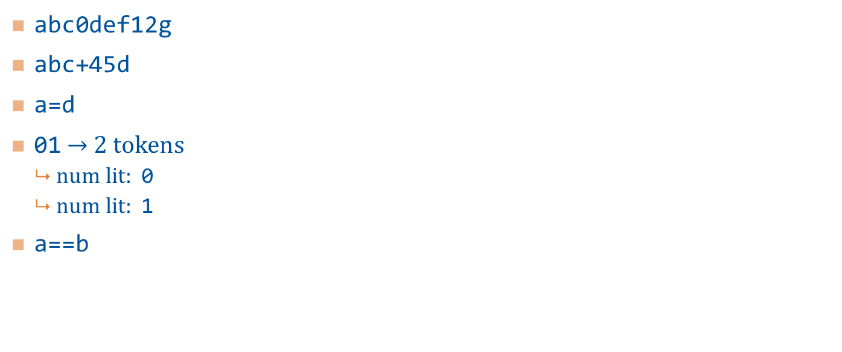
Lexing
<token> ::= <identifier> | <num lit> | <op>
<num lit> ::= <nonzero digit> <digit>* | 0
<digit> ::= 0 | <nonzero digit>
<nonzero digit> ::= 1 | 2 | 3 | 4 | 5 | 6 | 7 | 8 | 9
<identifier> ::= <identifier start> <identifier start>*
<identifier start> ::= A..Z | a..z | $ | _
<identifier part> ::= <identifier start> | <digit>
<op> ::= + | == | *
abc0def12g
abc+45d
a=d
01 $→$ 2 tokens
num lit: 0
num lit: 1
a==b

Slide 26
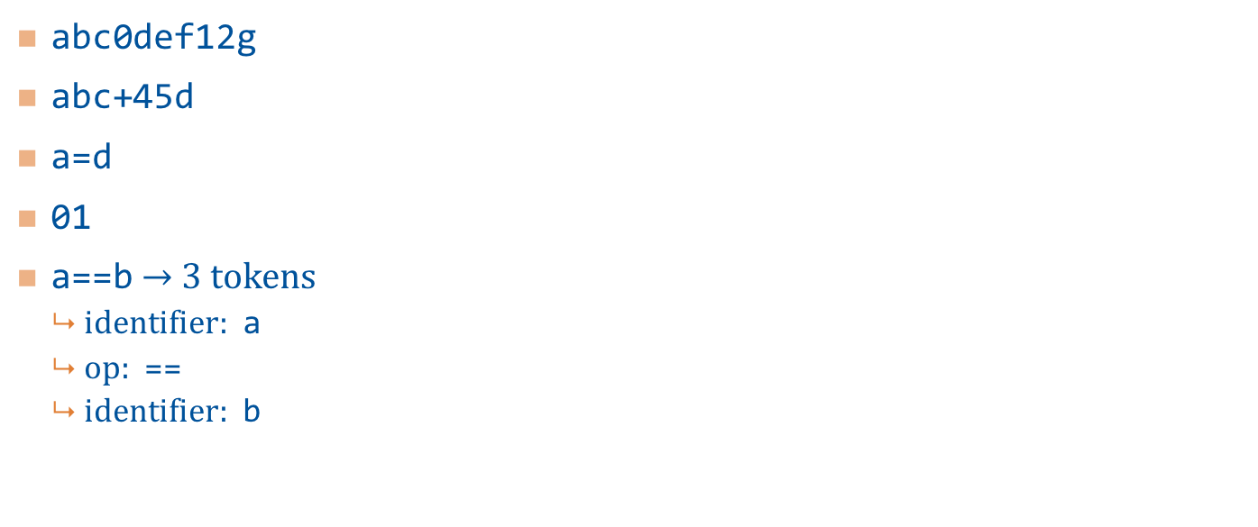
Lexing
<token> ::= <identifier> | <num lit> | <op>
<num lit> ::= <nonzero digit> <digit>* | 0
<digit> ::= 0 | <nonzero digit>
<nonzero digit> ::= 1 | 2 | 3 | 4 | 5 | 6 | 7 | 8 | 9
<identifier> ::= <identifier start> <identifier start>*
<identifier start> ::= A..Z | a..z | $ | _
<identifier part> ::= <identifier start> | <digit>
<op> ::= + | == | *
abc0def12g
abc+45d
a=d
01
a==b $→$ 3 tokens
identifier: a
op: ==
identifier: b

Slide 27
Implementing Ad-hoc [hand-written] Lexer
One at time, examine characters using class CharStream
If there is a one-character token, {+,*}, emit [announce] that token
If the character is =, then look at the next character:
If another = follows, emit the token ==
Otherwise throw an exception [announce an error]
If the character is a non-zero digit, continue reading until a non-digit
If the character is a letter, $, or _ , continue reading until the next character is not a letter, digit, $, or _
... and so on.

Slide 28
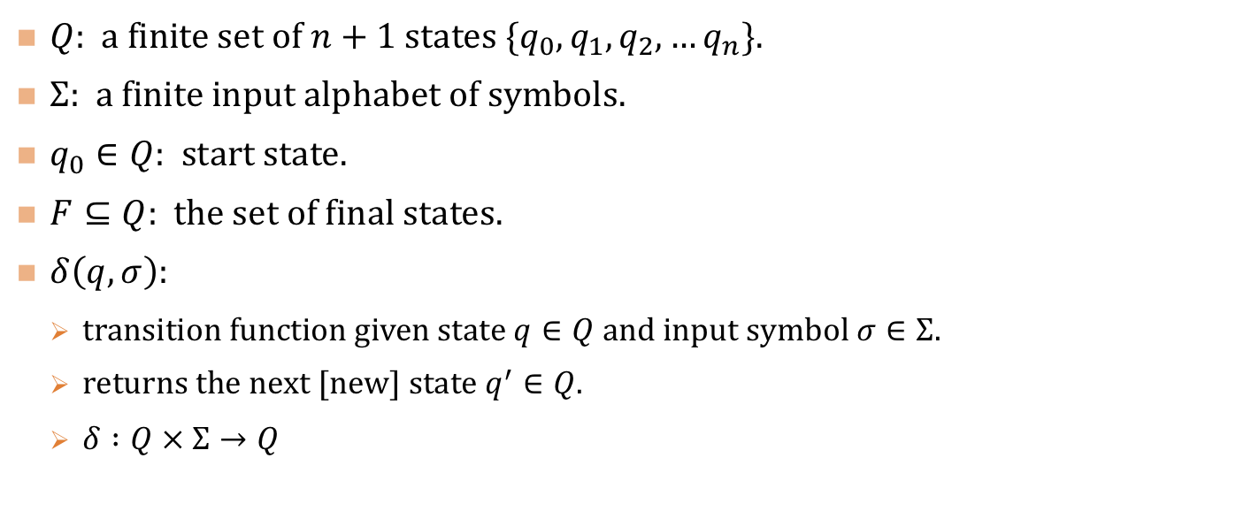
Finite State Automata
$Q$: a finite set of $n+1$ states $\{q_{0},q_{1},q_{2},…q_{n}\}$.
$Σ$: a finite input alphabet of symbols.
$q_{0}∈Q$: start state.
$F⊆Q$: the set of final states.
$δ\left(q,σ\right)$:
transition function given state $q∈Q$ and input symbol $σ∈Σ$.
returns the next [new] state $q^{′}∈Q$.
$δ :Q × Σ→Q$

Slide 29
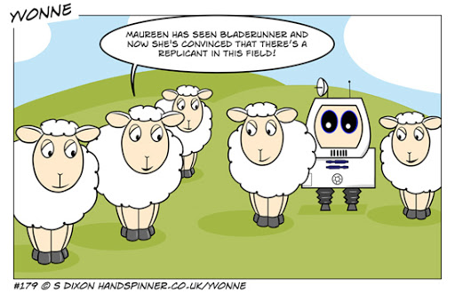
The Sheep Machine

Slide 30

The Sheep Machine
<sheep> ::= ba+!

Slide 31
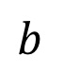

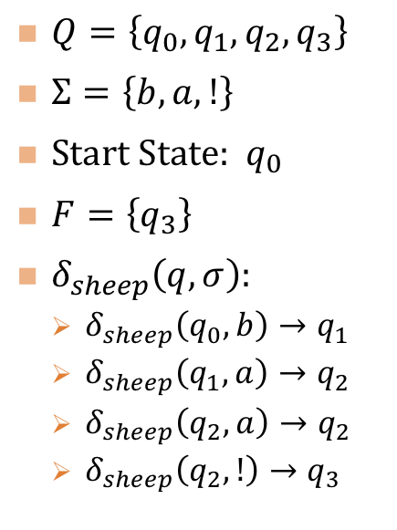

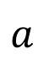

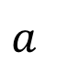


The Sheep Machine
$Q=\left\{q_{0},q_{1},q_{2}, q_{3}\right\}$
$Σ=\left\{b,a,!\right\}$
Start State: $q_{0}$
$F=\left\{q_{3}\right\}$
$δ_{sheep}\left(q,σ\right)$:
$δ_{sheep}\left(q_{0},b\right)→q_{1}$
$δ_{sheep}\left(q_{1},a\right)→q_{2}$
$δ_{sheep}\left(q_{2},a\right)→q_{2}$
$δ_{sheep}\left(q_{2},!\right)→q_{3}$
<sheep> ::= ba+!
$$b$$
$$a$$
$$!$$
$$q_{0}$$
$$q_{1}$$
$$q_{2}$$
$$q_{3}$$
$$a$$

Slide 32
LEXING
<token> ::= <identifier> | <num lit> | <op>
<num lit> ::= <nonzero digit> <digit>* | 0
<digit> ::= 0 | <nonzero digit>
<nonzero digit> ::= 1 | 2 | 3 | 4 | 5 | 6 | 7 | 8 | 9
<identifier> ::= <identifier start> <identifier part>*
<identifier start> ::= A..Z | a..z | $ | _
<identifier part> ::= <identifier start> | <digit>
<op> ::= + | == | *
Recall our grammar.
The following slides provide the DFA for this grammar.

Slide 33
DFA
Error
Not(a..z,A..Z,$,_,0..9, +,*,=)
a..z,A..Z,$,_
Start
+
Ident
=
Equal
*
1..9
0
+
a..z,A..Z,$,_,0..9
Digits
=
Not(=)
*
Zero
Double
Equal
Error
0..9

Slide 34
Whitespace
In many languages, whitespace characters (space, CR, LF, tab, etc.) serve to separate tokens, but are otherwise ignored.
Example: 12 34
The lexer returns 2 tokens
12
34
The space provides token separation and then is ignored

Slide 35
Scanning Whitespace
Skip over whitespace characters before the beginning token
Stop building a token when any character (including whitespace) cannot further extend the current token.
May need to look ahead. To see if the next character is from a set of delimiters.
<whitespace> :== ‘ ’ | \t | \n | \r

Slide 36
DFA
Error
Not(a..z,A..Z,$,_,0..9, +,*,=)
a..z,A..Z,$,_
Start
+
<whitespace>
Ident
=
Equal
*
1..9
0
+
a..z,A..Z,$,_,0..9
Digits
=
Not(=)
*
Zero
Double
Equal
Error
0..9

Slide 37
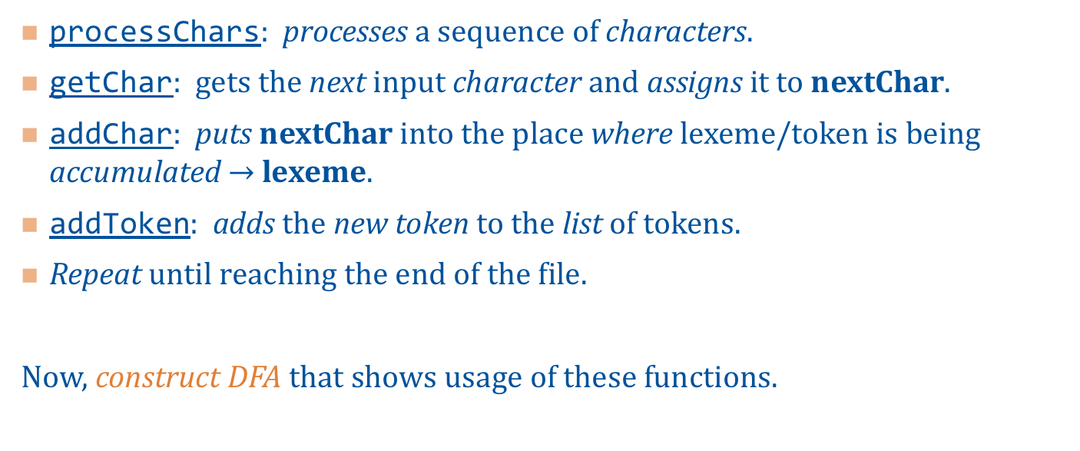
A Functional Process Sketch
processChars: processes a sequence of characters.
getChar: gets the next input character and assigns it to nextChar.
addChar: puts nextChar into the place where lexeme/token is being accumulated $→$ lexeme.
addToken: adds the new token to the list of tokens.
Repeat until reaching the end of the file.
Now, construct DFA that shows usage of these functions.

Slide 38

processChars
Letter | Digit
addChar;
getChar;
Letter
id boundary
id
addChar;
getChar;
chars
$$q_{0}$$
Digit
token
addToken;
addChar;
getChar;
repeat
addChar;
getChar;
int
Digit
int boundary

Slide 39
Lexing Comments
Like whitespace, comments might separate tokens and are often simply discarded [ignored].
Pragmas: are special comments containing information useful to the compiler and other tools.
Hints to compiler | tools how for better code generation, turning run time checks on | off, and so on.
In Ada: unchecked pragma turns off type checking.
OpenMP pragmas annotate C | C++ about generating parallel code. Ignored by non-OpenMP aware compilers.

Slide 40
Lexing Comments
Similar to whitespace, comments might separate tokens and are often simply discarded [ignored].
Pragmas: are special comments containing information useful to the compiler and other tools.
If a language supports pragmas, then they must be handled, not ignored.
[Our project does not support pragmas.]

Slide 41
Reserved Words
Tokens that follow the rules for identifiers but are not allowed to be identifiers.
Java Examples: class, int, public, instanceof, if, while, etc.
A keyword is a reserved word that has a special meaning in the program.
Java Example: goto is reserved, but not a keyword.
In many languages, the set of keywords equals the reserved words.

Slide 42
Example: Reserved Word if
Tokenize: ifa
One token
An identifier
ifa
Tokenize: if+
Two tokens
The reserved word if
Followed by the operator +

Slide 43
Handling Reserved Words in a Lexer
Modifying the DFA to account for reserved words:
Results in significant complications in the DFA.
Not feasible unless the DFA is auto-generated.
Easier approach
Lexer has a list of reserved words.
After an identifier has been recognized, check list.
Ok, since set of reserved words is finite and fixed at language design time.
Can store in a way that allows fast lookup [i.e., HashMap].
If a reserved word, return appropriate token type, otherwise return identifier.

Slide 44
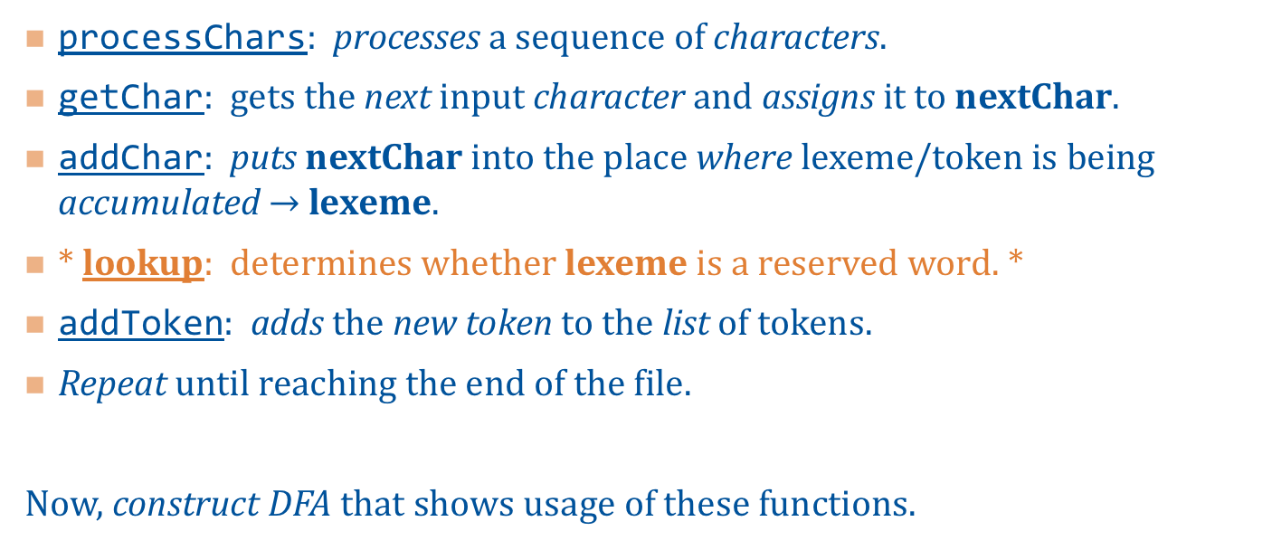
A Functional Process Sketch
processChars: processes a sequence of characters.
getChar: gets the next input character and assigns it to nextChar.
addChar: puts nextChar into the place where lexeme/token is being accumulated $→$ lexeme.
* lookup: determines whether lexeme is a reserved word. *
addToken: adds the new token to the list of tokens.
Repeat until reaching the end of the file.
Now, construct DFA that shows usage of these functions.

Slide 45
A Functional Process Sketch
processChars: processes a sequence of characters.
getChar: gets the next input character and assigns it to nextChar.
addChar: puts nextChar into the place where lexeme/token is being accumulated $→$ lexeme.
* lookup: determines whether lexeme is a reserved word. *
addToken: adds the new token to the list of tokens.
Repeat until reaching the end of the file.
Now, construct DFA that shows usage of these functions.
Our Project:
Will NOT address keyword lookup [identification] in the Lexer.
Instead, we will handle keywords during the Analyzer.

Slide 46
processChars
Letter | Digit
addChar;
getChar;
Letter
id boundary
id
addChar;
getChar;
lookup;
chars
$$q_{0}$$
Digit
token
addToken;
addChar;
getChar;
repeat
addChar;
getChar;
int
Digit
int boundary

